Slide 1


Muhammad Chosasih Mahendra
March 27, 2022

Slide 2

Outline
Executive Summary
Introduction
Methodology
Results
Conclusion
Appendix
3
4
5
17
45
46

Slide 3
Executive Summary
Summary of methodologies
- Data Collection : API and Web Scraping
- Data Wrangling
- Exploratory Data Analysis : SQL and Data Viz
- Interactive Visualization : Folium
- Machine Learning Model Prediction
Summary of all results
- EDA result
- Data Visualization
- Predictive Modeling result

Slide 4
Introduction
Project background and context
SpaceX advertises Falcon 9 rocket launches on its website with a cost of 62 million dollars; other providers cost upward of 165 million dollars each, much of the savings is because SpaceX can reuse the first stage. Therefore, if we can determine if the first stage will land, we can determine the cost of a launch. This information can be used if an alternate company wants to bid against SpaceX for a rocket launch. The goal of this project is to predict if the first stage of Falcon 9 will land successfully.
Problems you want to find answers
What factors affect the success of landing Falcon 9 in the first stage?
The relationship between variables that affect the success rate of the first stage landing of Falcon 9.

Slide 5

Section 1

Slide 6
Methodology
Executive Summary
Data collection methodology:
Data was collected from Spacexdata API and Wikipedia web scraping.
Perform data wrangling
Label encoding was performed to Outcome feature
Perform exploratory data analysis (EDA) using visualization and SQL
Perform interactive visual analytics using Folium and Plotly Dash
Perform predictive analysis using classification models
How to build, tune, evaluate classification models

Slide 7
Data Collection
Data was collected from Spacexdata API and Wikipedia web scraping.
Spacexdata API
Making request to the api.spacexdata.com.
Decode the response content as a Json and turn it into Pandas data frame.
Select only relevant features to target variable, rename column, filter only Falcon 9 launches, and cleaning the data.
Wikipedia Web Scraping
Using BeautifulSoup library, extract Falcon 9 launch records HTML table from Wikipedia, parse the table and convert it into a Pandas data frame.

Slide 8
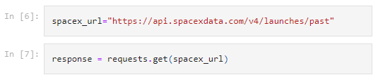
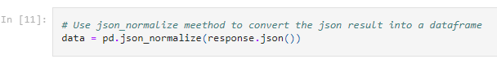
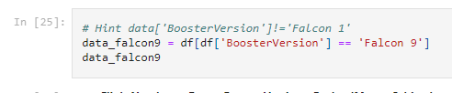
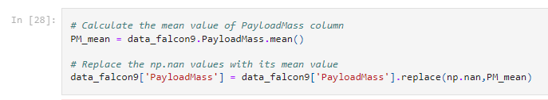
Data Collection – SpaceX API
Making request to api.spacexdata.com, decode the response, and perform data wrangling.
This is the link for the notebook

Slide 9
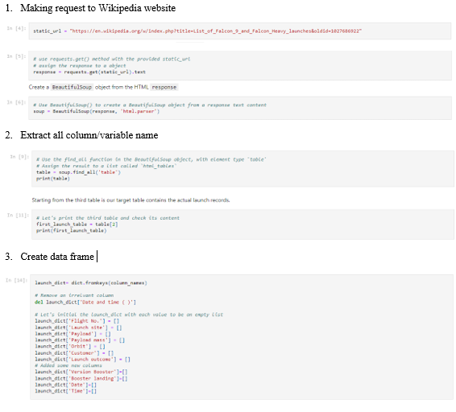
Data Collection - Scraping
Using BeautifulSoup library, extract Falcon 9 launch records HTML table from Wikipedia, parse the table and convert it into a Pandas data frame.
This is the link for the notebook

Slide 10
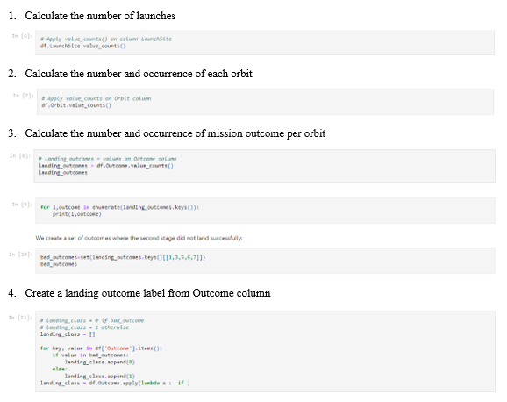
Data Wrangling
Perform initial EDA and determine training labels.
This is the link for the notebook

Slide 11
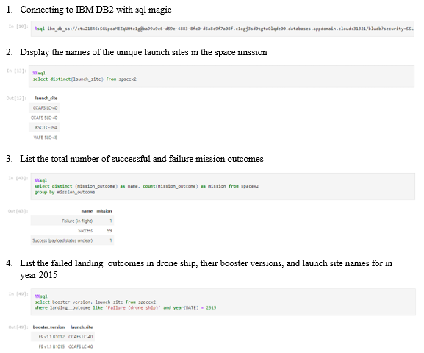
EDA with SQL
Connecting python to IBM DB2 and querying data. Here some example of the insight from querying.
This is the link for the notebook

Slide 12
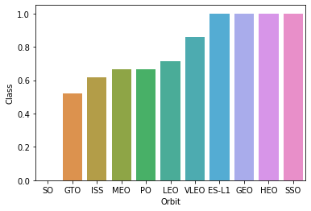
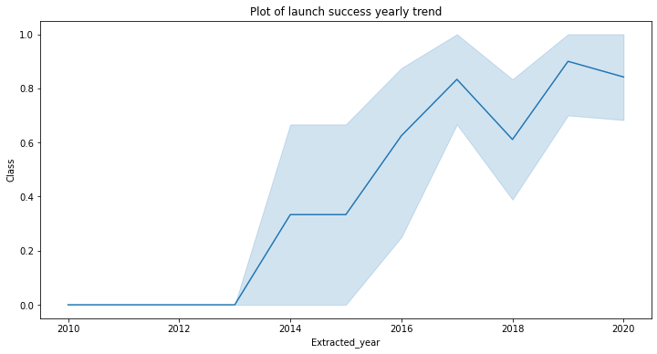
EDA with Data Visualization
Relationship between success rate of each orbit type
The launch success yearly trend
This is the link for the notebook

Slide 13
Build an Interactive Map with Folium
We marked all launch sites on a map and the success/failed launches for each site on the map.
Using color mapping, we identified which launch site have relative high success rate.
We calculate the distances between a launch site to its proximities to answer possible questions like:
Are launch sites in close proximity to railways?
Are launch sites in close proximity to highways?
Are launch sites in close proximity to coastline?
Do launch sites keep certain distance away from cities?
This is link to the notebook

Slide 14
Build a Dashboard with Plotly Dash
We created an interactive dashboard to make visual analysis easier.
The dashboard can solve possible questions like:
Which site has the largest successful launches?
Which site has the highest launch success rate?
Which payload range(s) has the highest launch success rate?
Which payload range(s) has the lowest launch success rate?
Which F9 Booster version (v1.0, v1.1, FT, B4, B5, etc.) has the highest?
This is the link for the python app

Slide 15
Predictive Analysis (Classification)
Steps Data Analysis:
Assign Features and Target Variable to X and y.
Standardize the data
Split train and test data
Classification method used in analysis:
K-nearest neighbors
Decision Tree
Logistic Regression
SVM
Find best hyperparameter using GridSearchCV
This is link to the notebook

Slide 16
Results
Exploratory data analysis results
Interactive analytics demo in screenshots
Predictive analysis results

Slide 17

Section 2

Slide 18
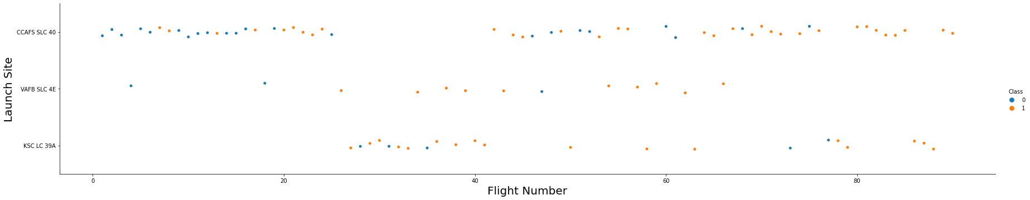
Flight Number vs. Launch Site
Larger flight number leads to increasing success rate, especially in CCAFS SLC 40 launch site.

Slide 19
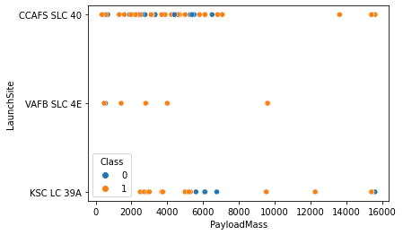
Payload vs. Launch Site
No heavy payload (mass > 10000) rockets launched from VAFB-SLC .
Heavy payload rockets more successful launched from CCAFS SLC 40.
Most used launch pad is CCAFS SLC 40.

Slide 20
Success Rate vs. Orbit Type
ES-L1, GEO, HEO, SSO orbit type has zero failed launched rockets, while SO orbit type never had successful launched rockets.
GTO orbit type have lowest success rate launched rocket.

Slide 21
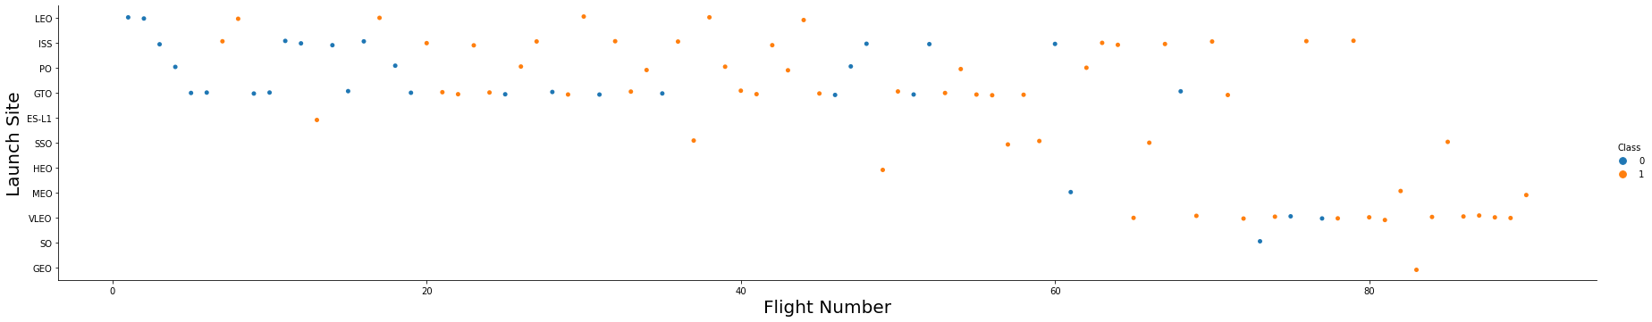
Flight Number vs. Orbit Type
More flight number leads to increasing success rate on LEO orbit, but GTO orbit has no relationship with flight number.

Slide 22
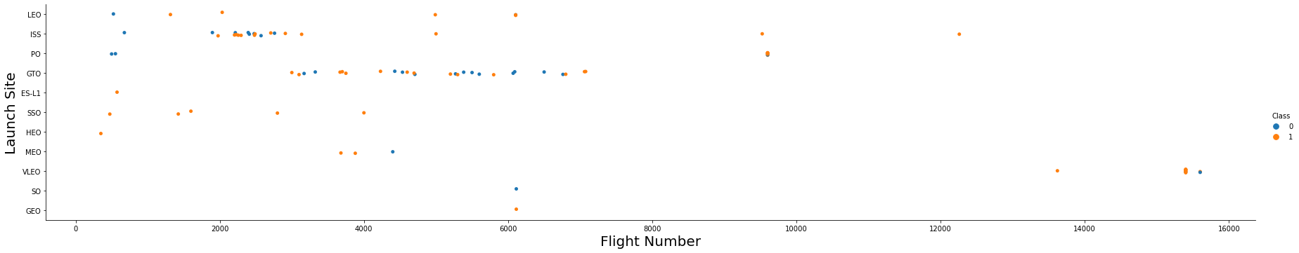
Payload vs. Orbit Type
With heavy payloads, the successful landing rate are more for Polar, LEO and ISS orbit type.
For GTO orbit we can’t determine its relationship with payload.

Slide 23

Launch Success Yearly Trend
From 2013 to 2020, success rate trend is positive.
Declining period of success rate happened in 2017-2018.

Slide 24
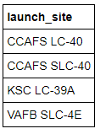
All Launch Site Names
SpaceX data have four unique launch site name.

Slide 25
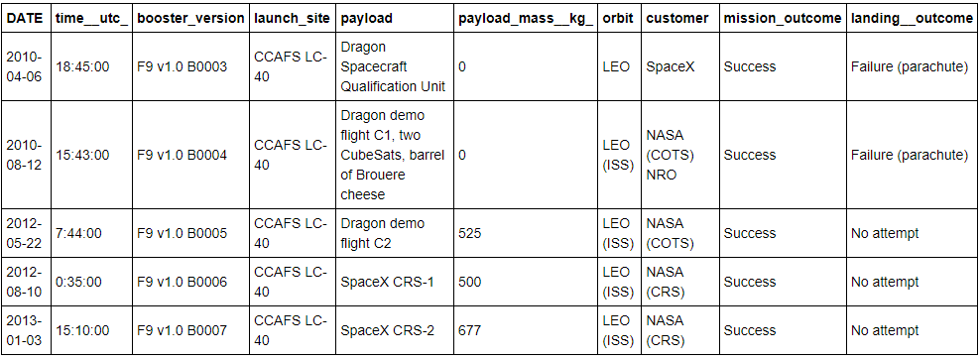
Launch Site Names Begin with 'CCA'
Showing 5 records where launch sites begin with `CCA`

Slide 26
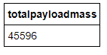
Total Payload Mass
Total payload mass carried by booster launched by NASA (CRS) is 45 596

Slide 27
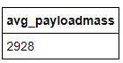
Average Payload Mass by F9 v1.1
Average payload mass carried by booster launched by F9 v1.1 is 2 928

Slide 28
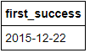
First Successful Ground Landing Date
First successful ground landing was on 22nd December 2015.

Slide 29
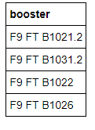
Successful Drone Ship Landing with Payload between 4000 and 6000
Successful drone ship landing with payload > 4000 and < 6000 are
F9 FT B1021.2, F9 FT B1031.2, F9 FT B1022, F9 FT B1026.

Slide 30
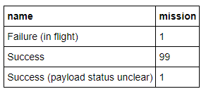
Total Number of Successful and Failure Mission Outcomes
Total successful missions are 100, and total failure mission is 1.

Slide 31
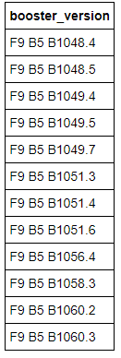
Boosters Carried Maximum Payload
Total boosters that carried maximum payload is 11.

Slide 32
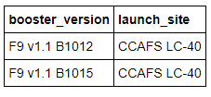
2015 Launch Records
List of failed landing in drone ship in 2015.

Slide 33
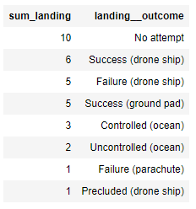
Rank Landing Outcomes Between 2010-06-04 and 2017-03-20
Landing outcome between 2010-06-04 and 2017-03-20, ranked.

Slide 34

Section 3

Slide 35
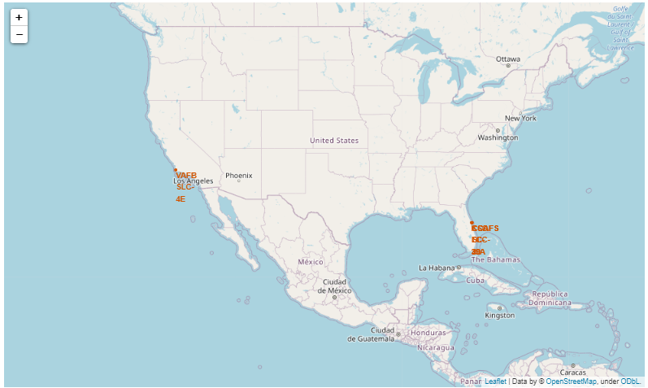
Launch Sites Map
SpaceX launch sites are in California and Florida, USA.

Slide 36
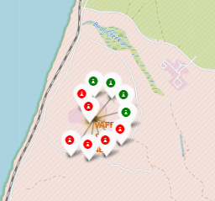
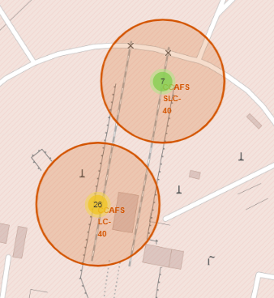
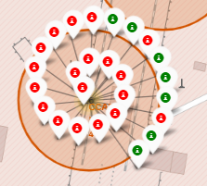
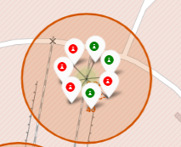
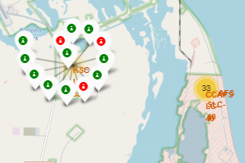
Success/Failed Launches
California
Florida
4 success, 6 failed, only in one location.
Three different locations.

Slide 37
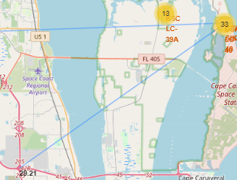

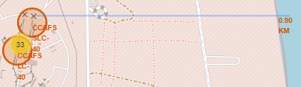
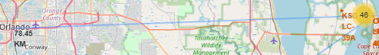
Launch Sites Distance to Landmarks
Distance to closest highway
Launch site far from closest railway station.
Launch site far from closest highway.
Launch site close to coastline.
Launch site far from closest city.
Distance to closest coastline
Distance to closest city

Slide 38

Section 4

Slide 39

Success Launch on Each Launch Site
Most successful launch site is KSC LC-39A.

Slide 40

Launch Site with Highest Success Ratio (KSC LC-39A)
KSC LC-39A has success rate 76.9% and failure rate 29.1%.

Slide 41

Payload vs Outcome (with payload range slider)
Light Load ( <= 4000 )
Heavy Load ( 4000 - 10000 )
Lower payload have higher success rate than heavy payload.

Slide 42

Section 5

Slide 43
Classification Accuracy
The highest classification accuracy is the model with Decision Tree.

Slide 44
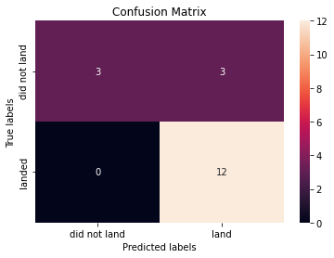
Confusion Matrix (Decision Tree)
The model doesn’t have false negative but have 20% of false positive.

Slide 45
Conclusions
The larger the flight number and the lower payload mass leads to better success rate at launch sites.
Rocket launch overall success rate has positive trend between 2013-2020, although had minor negative trend in 2017-2018.
Orbit type with most success rate are ES-L1, GEO, HEO, SSO and VLEO.
Most successful launch site is KSC LC-39A.
All launch site is far from railway, highway, city, and close to coastline.
Decision Tree is best classification model for this project, with parameters criterion: gini, max_depth: 6, max_features: auto, min_samples_leaf: 2, min_samples_split: 5, splitter: random.

Slide 46
Appendix
All relevant assets like Python code snippets, SQL queries, charts, Notebook outputs, or data sets are available on GitHub.

Slide 47


